Slide 1

UR CANTEEN
By:
Nitaj itnare (sceta128)
Ishan Bhardwaj(sceta133)
Shashvat umbarkar(sceta127)

Slide 2
Shneiderman’s 8 golden rules of interface design
1 Strive for consistency.
2 Enable frequent users to use shortcuts.
3 Offer informative feedback.
4 Design dialog to yield closure.
5 Offer simple error handling.
6 Permit easy reversal of actions.
7 Support internal locus of control.
8 Reduce short-term memory load.

Slide 3
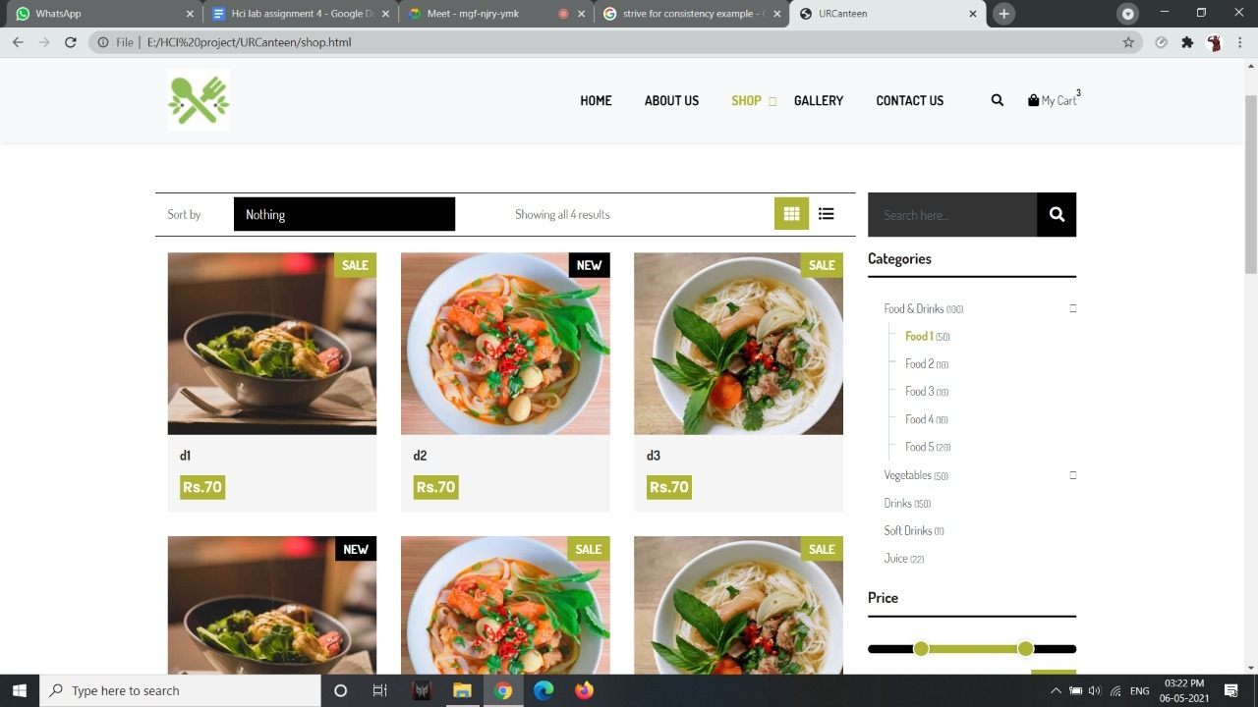
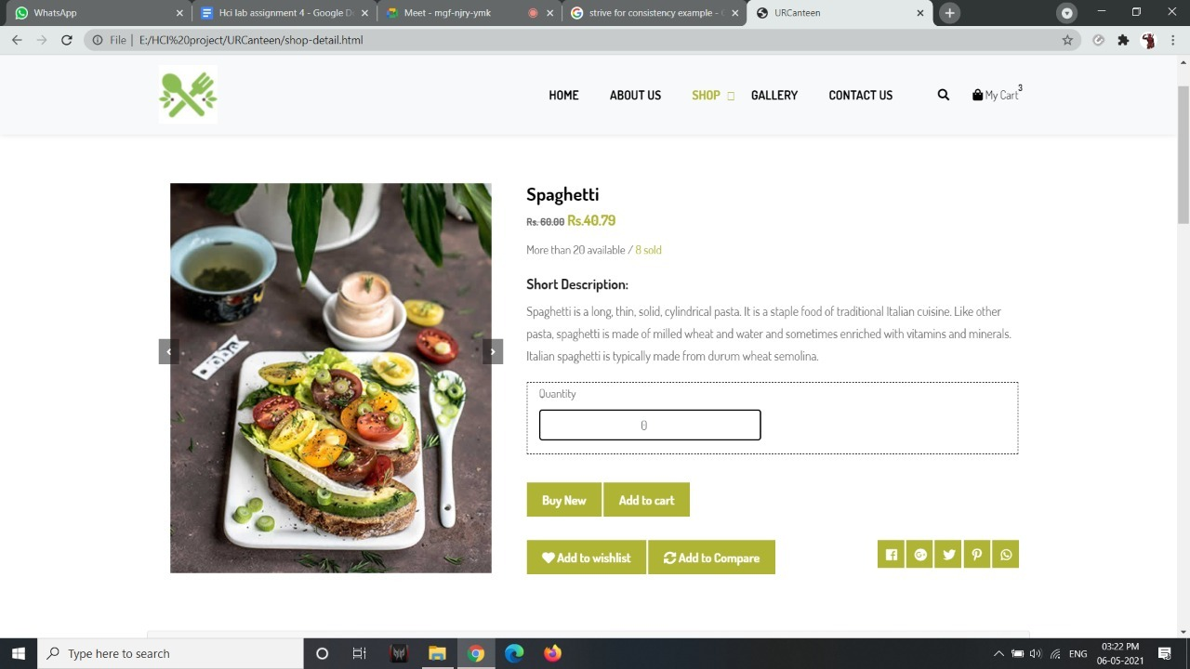
Strive for consistency

Slide 4
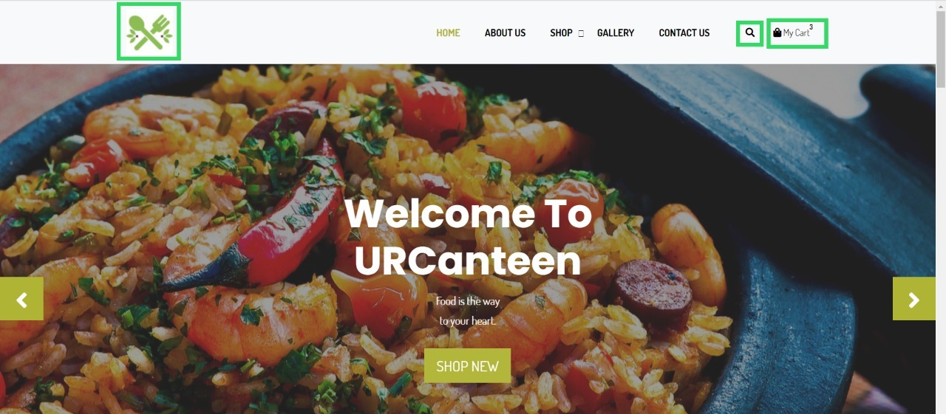
Enable frequent users to use shortcuts

Slide 5
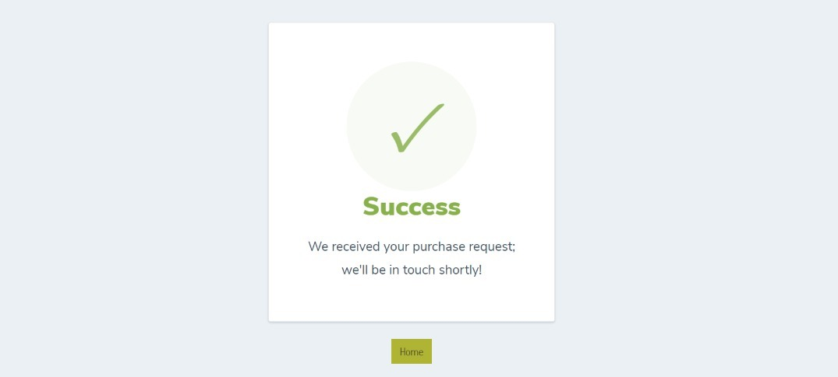
Offer informative feedback

Slide 6
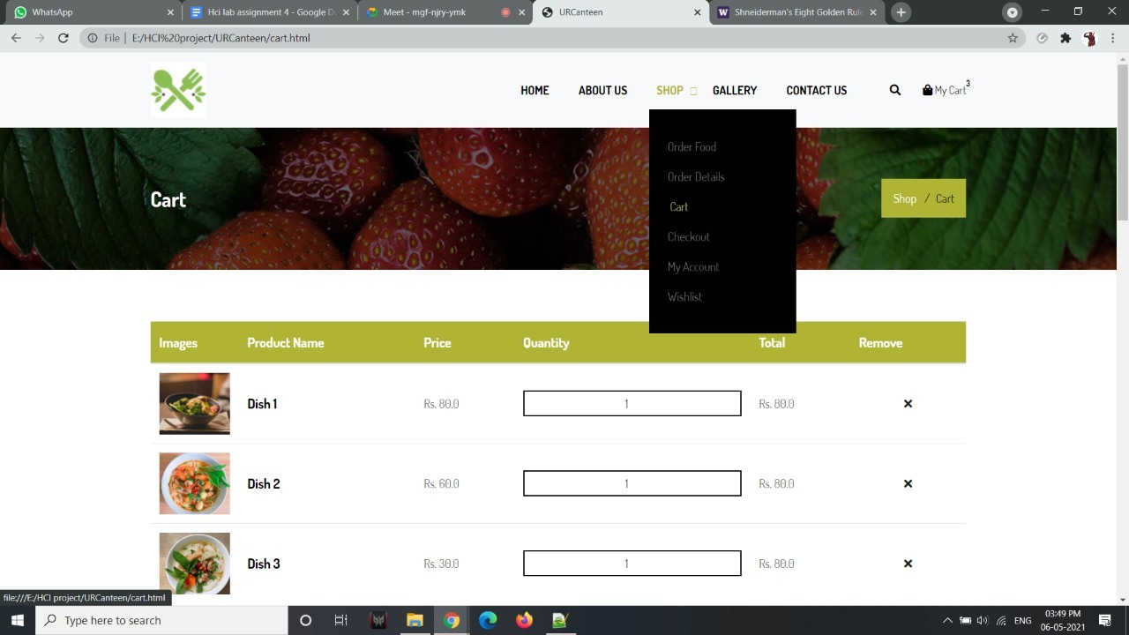
Design dialog to yield closure

Slide 7
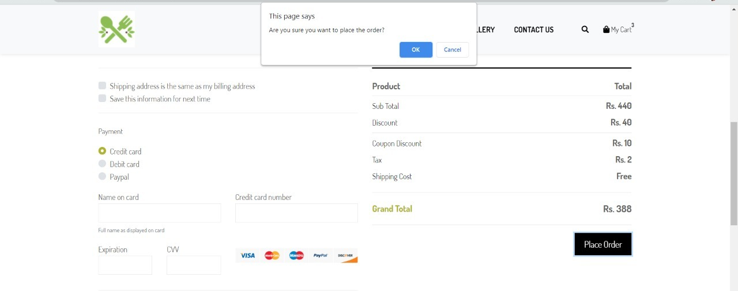
Offer simple error handling

Slide 8
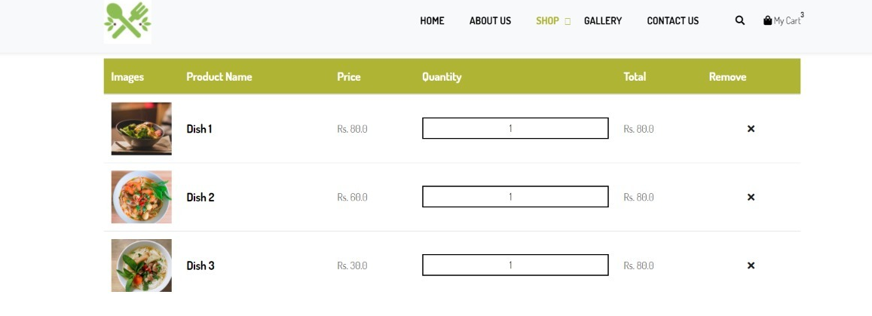
Permit easy reversal of actions

Slide 9
Support internal locus of control
Locus of control is the degree to which people believe that they, as opposed to external forces (beyond their influence), have control over the outcome of events. We make sure that there is no automation in the booking process of the meal the user has the full control over the booking and ordering process.

Slide 10
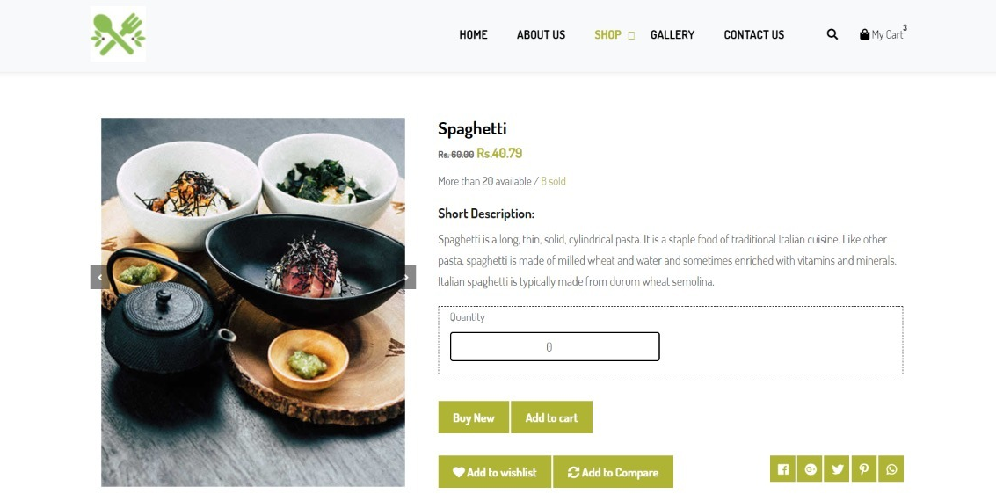
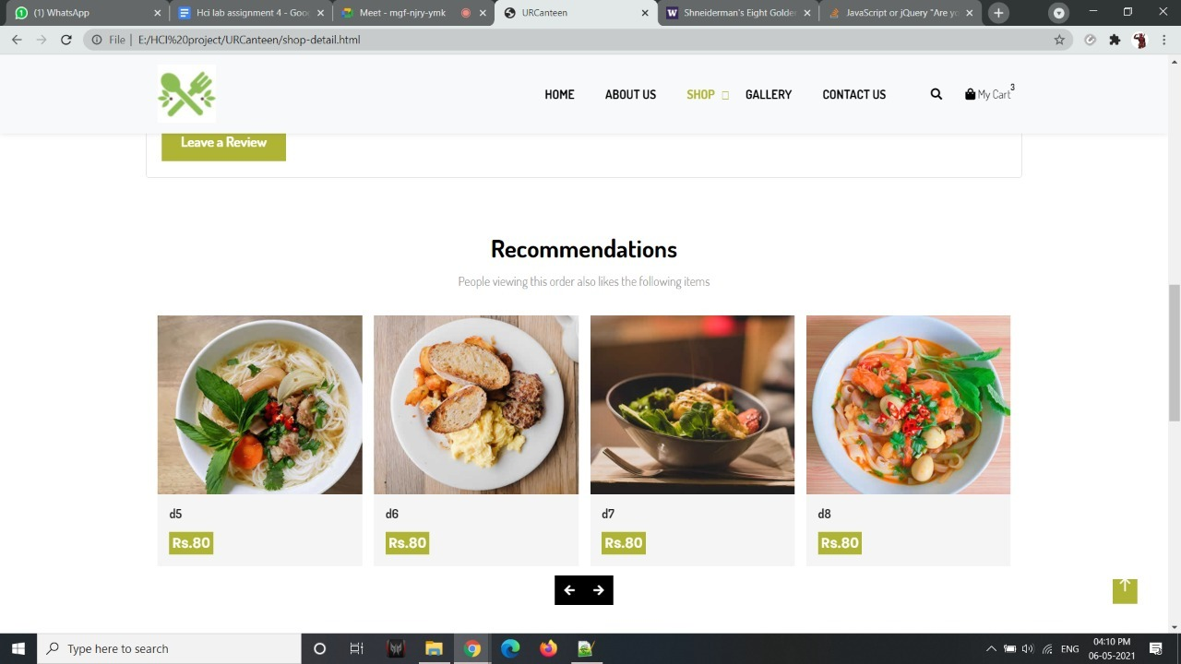
Reduce short-term memory load

Slide 11
THANKS!

